Slide 1
Thinking and language

Slide 2
Cognition: The mental activities associated with thought, knowledge, and memory
Thinking: involves the manipulation of mental representations of various features of the external world
Reasoning: mental activity through which we transform available information in order to reach conclusions
Decision making: the process of choosing between two or more alternatives on the basis of information about them
Problem solving: processing information in various ways in order to move toward desired goals.

Slide 3
Basic elements of thoughts
Thinking is the mental activity that allows us to understand, process, and communicate information.
Basic elements of thought—how, aspects of the external world are represented in our thinking.; how available information is processed cognitively in order to reach specific conclusions.
Concepts: Mental categories for objects or events that are similar to one another in certain respects
Artificial and Natural Concepts:
Artificial concepts can be clearly defined by a set of rules or properties
Natural concepts have no fixed or readily specified set of defining features
Prototypes: The best or clearest examples of various objects or stimuli in the physical world
Probabilistic strategy: The more similar an object or event is to others already in the category, especially to the prototype for the category, the more likely we are to include the new item within the concept

Slide 4
How are concepts represented
Concepts may be represented in terms of their features or attributes
Visual Images: Mental pictures or representations of objects or events
Schemas: cognitive frameworks that represent our knowledge of and assumptions
about the world (self-schema)
Propositions: Sentences that relate one concept to another and can stand as separate assertions
Images: Mental pictures of the world

Slide 5
reasoning
Formal versus Everyday Reasoning
Formal reasoning: reasoning, all the required information is supplied; the problem to be solved is straightforward; there is typically only one correct answer; the reasoning applies follows a specific method.
Eg: Syllogistic reasoning: A type of formal reasoning in which two premises are used as the basis for deriving logical conclusions
Premise: All people who are churchgoers are honest.
Premise: All politicians are churchgoers.
Conclusion: Therefore, all politicians are honest.
Formal reasoning is aided by correct premise

Slide 6
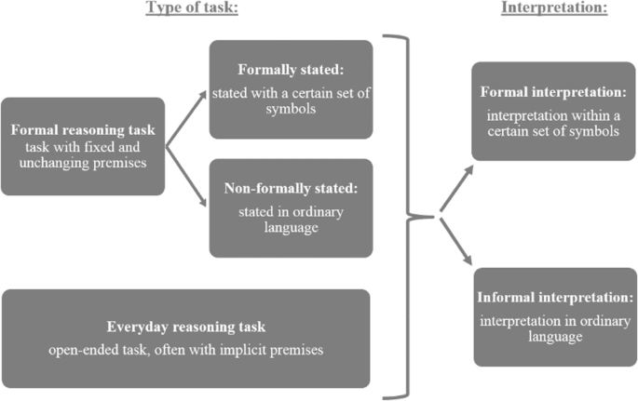
Everyday reasoning: premises might be implicit or not provided at all;
Established procedures are often not available and it depends on the situation when an answer is a good fit
Are [often] not self-contained and the content of the problem typically has potential personal relevance

Slide 7
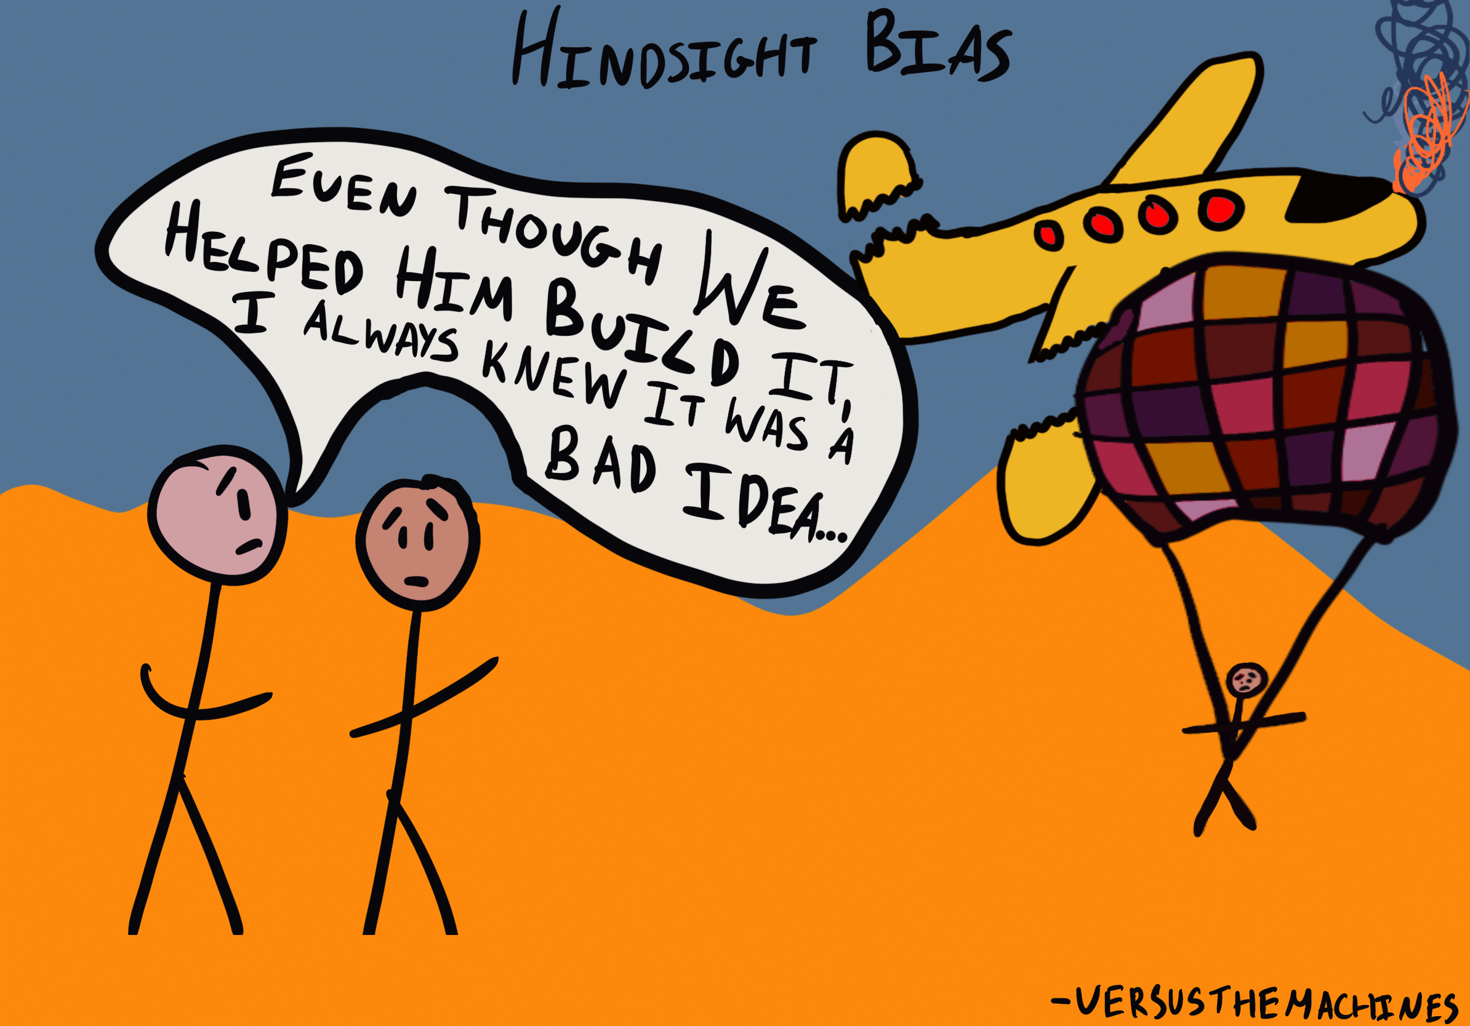
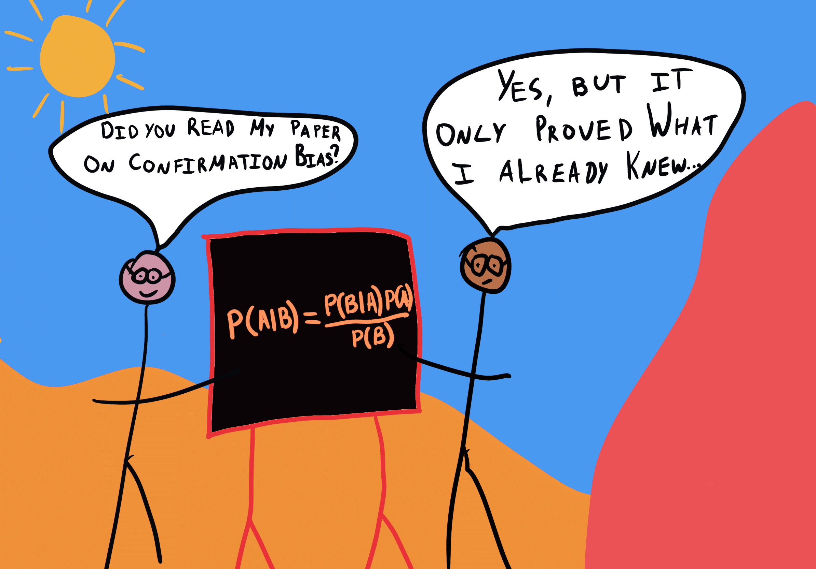
Sources of error in reasoning
Role of mood states: current moods or emotions (positive and negative) can dramatically reduce our ability to reason effectively (Forgas, 1995)
Role of beliefs: often influenced by emotion-laden beliefs: focusing on facts
Social context: aspects of the social context contribute significantly to the accuracy of the conclusions we reach
Confirmation bias: The tendency to pay attention primarily to information that confirms existing views or beliefs: failure to consider alternatives
Hindsight Effect: The tendency to assume that we would have been better at predicting actual events than is really true.

Slide 8
Decision making
Decision Making: The process of choosing among various courses of action or alternatives
Expected Utility: The product of the subjective value of an event and its predicted probability of occurrence

Slide 9
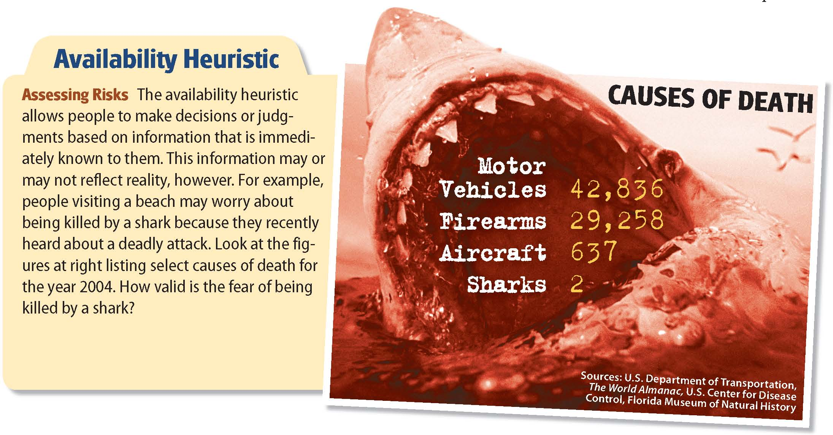
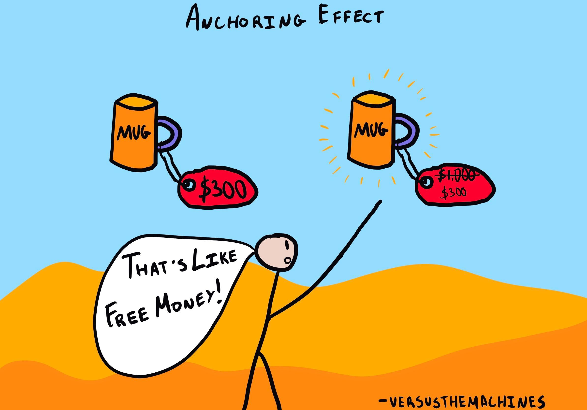
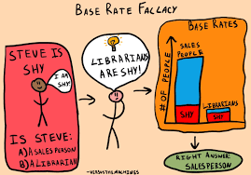
Heuristics: Mental rules of thumb that permit us to make decisions and judgments in a rapid and efficient manner
Availability Heuristic: A cognitive rule of thumb in which the importance or probability of various events is judged on the basis of how readily they come to mind: help people make decisions on the basis of available information in their immediate consciousness
Representativeness heuristic: A mental rule of thumb suggesting that the more closely an event or object resembles typical examples of some concept or category, the more likely it is to belong to that concept or category
Anchoring-and-Adjustment Heuristic: A cognitive rule of thumb for decision making in which existing information is accepted as a reference point but then adjusted in light of various factors

Slide 10
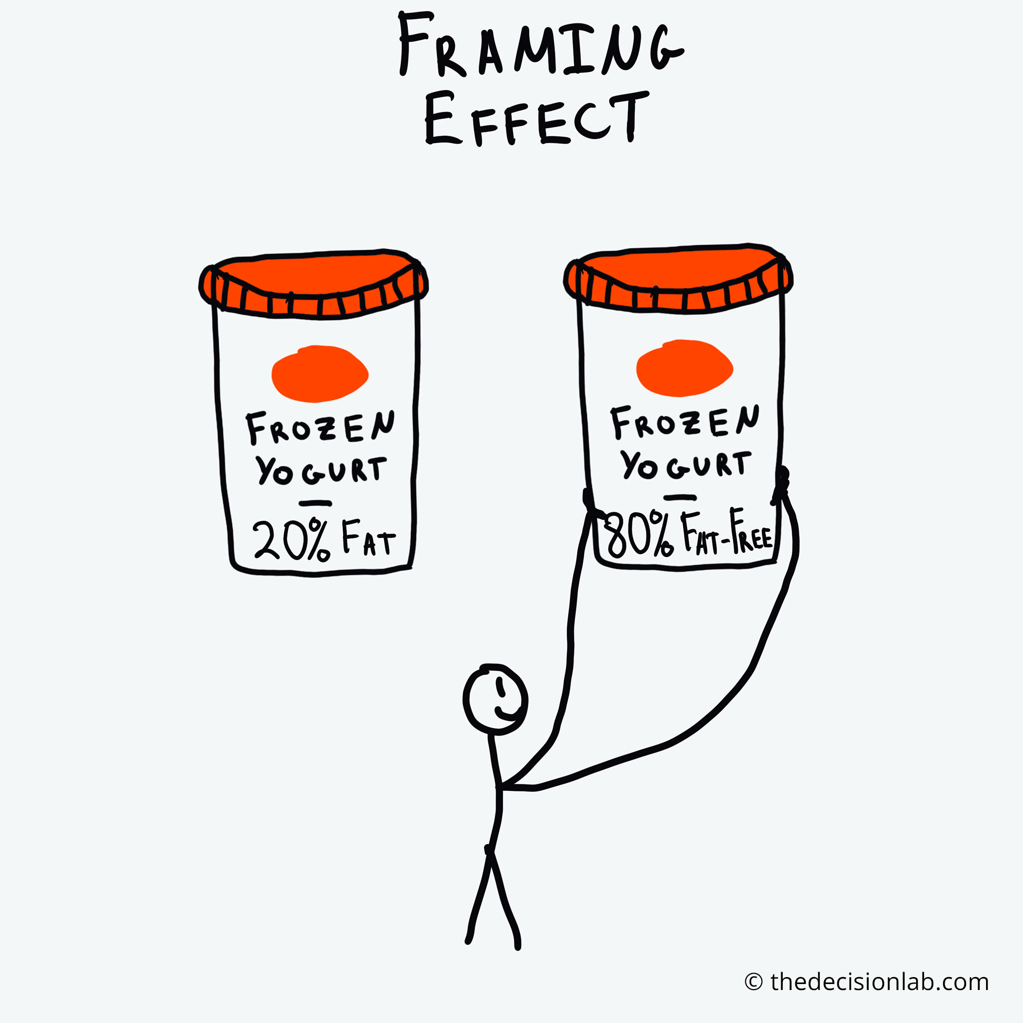
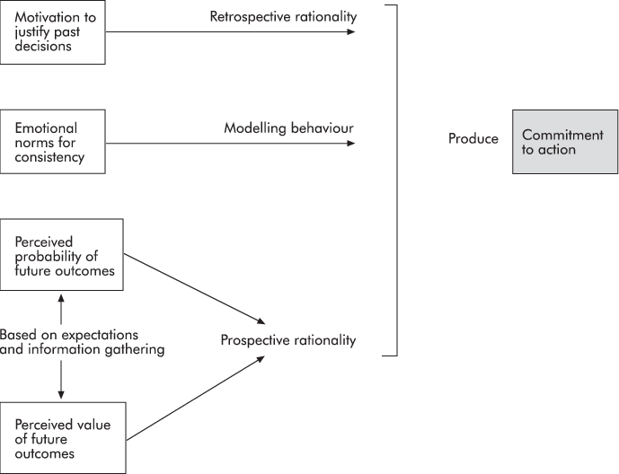
Framing: Presentation of information concerning potential outcomes in terms of gains or in terms of losses
Escalation of Commitment: The tendency to become increasingly committed to bad decisions even as losses associated with them increase

Slide 11
Initial Phase: Decision based on rational considerations
Early losses: psy.cal factors come into play: reluctance to admit error/ desire for self-justification
Continuing losses: External factors: Social pressure/ political forces
Escalation of commitment
Factors reducing commitment:
Limited resources
Overwhelming evidence of failure
Diffusion of personal responsibility
Overview of escalation of commitment

Slide 12
Naturalistic Decision Making: movement toward studying decision making as it occurs in applied or real-world settings, away from laboratories
Several key findings derived from laboratory research may not accurately depict decision making in the natural environment
Focuses attention on how people bring their experience to bear in making decisions: individual differences contribute to the type and the quality of decisions they make
Naturalistic decision making broadens the focus from a single decision “event” to include elements of the decision context
Emphasizes the dynamic nature of decision making and takes into account the complexity of modern decision environments—including the potentially enormous costs of making bad decisions, both in terms of money and loss of life.
Application: include military and health care settings, the courtroom, and the like

Slide 13
Base rate-problem: people tend to ignore the relative frequency of various events when making decisions, instead of opting for simpler heuristics.
E.g.: If given a general description of a person and then asked to judge whether the person is a surgeon or engineer, many people tend to rely on the representativeness heuristic—making their judgment merely on the basis of how closely the description matches the central features of each occupation, and ignoring the fact that there are many more engineers than surgeons.
Some researchers (e.g., Koehler, 1996) have argued that laboratory tasks are often contrived and lack contextual information that people have available to them when making judgments in everyday life
Experience may also play a role: as people gain experience with specific types of judgments, they are more likely to consider base rates in their decisions

Slide 14
Problem solving
Problem Solving: Efforts to develop or choose among various responses in order to attain desired goals
Stage 1: Problem identified and understood
Stage 2: Potential solutions generated
Stage 3: Solutions examined and evaluated
Re-assessment and evaluation of solutions
Stage 4: Solutions tried, results evaluated

Slide 15
Problem solving: Methods
Trial and Error: A method of solving problems in which possible solutions are tried until one succeeds
Algorithm: A rule that guarantees a solution to a specific type of problem
Means–Ends Analysis: A technique for solving problems in which the overall problem is divided into parts and efforts are made to solve each part in turn
Analogy: A strategy for solving problems based on applying solutions that were previously successful with other problems similar in underlying structure
Metacognitive Processing: An expanded level of awareness that allows us, in a sense, to observe ourselves in the problem-solving process

Slide 16
Metacognitive processing (Berardi-Coletta et al., 1995) experiment: Four studies were conducted to demonstrate that the positive effects of verbalization on solution transfer found in previous studies were not due to verbalization per se but to the metacognitive processing involved in the effort required to produce explanation for solution behaviors
In Experiments 1, 2, and 3, a distinction was made between process-oriented, problem-oriented, and simple "think aloud" verbalizations.
The process-oriented (metacognitive) solvers performed significantly better than nonprocess control groups on both training and transfer tasks.
Experiment 4 further demonstrated this effect by showing that process-oriented participants consistently form more sophisticated problem representations and develop more complex strategies

Slide 17
In one experiment, participants were allowed to practice solving progressively more difficult versions of a playing-card problem, then were tested on the most difficult one
The problem involved ordering a set of playing cards so that when the cards were dealt they appeared in a prescribed order (ace, one, two, three, etc.): what made the problem difficult was a complicated dealing rule.
During the practice trials, participants were assigned to one of three groups: a group in which the experimenters induced metacognitive processing by asking participants process-oriented questions as they practiced (“How are you deciding on a way to work out the order for the cards?”); a group in which participants were asked problem-focused questions (“What is the goal of the problem?”); or a control group in which participants merely worked on the problem with no additional instructions or discussion
The results indicated that the participants in the metacognitive condition performed best on the task, taking the least number of trials to obtain the correct solution
In contrast, participants in the problem-focused group performed worst, requiring the most trials to solve the problem
The results indicate that talking through a problem can be useful—especially when it leads to metacognitive processing and a focus on the problem-solving process.; highlights that focusing solely on the problem can have detrimental effects—in this case, making reaching a solution more difficult.
Please note: merely talking aloud is not enough. Verbalization must be process-oriented to trigger metacognitive processing.

Slide 18
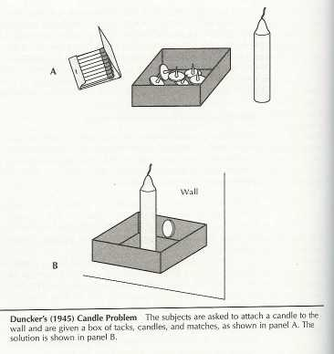
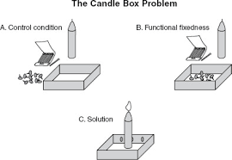
Factors affecting effective problem solving
Functional Fixedness: The tendency to think of using objects only as they have been used in the past

Slide 19
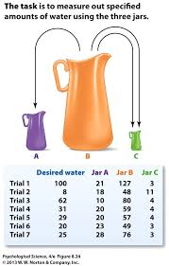
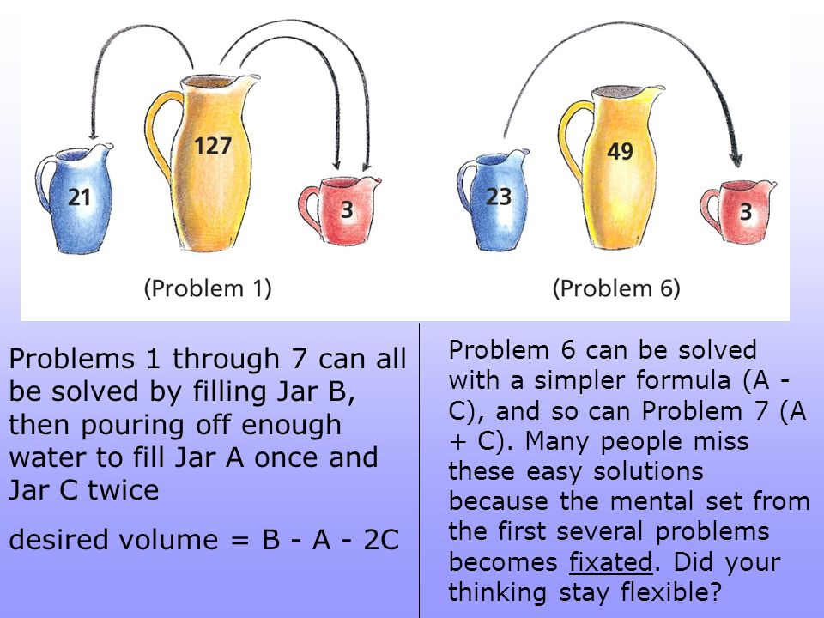
Mental Set: The impact of past experience on present problem solving; specifically, the tendency to retain methods that were successful in the past even if better alternatives now exist
Luchins, 1942

Slide 20
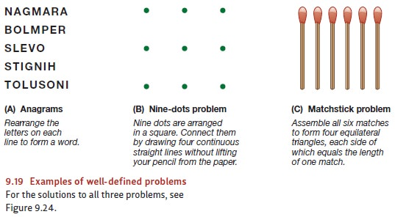
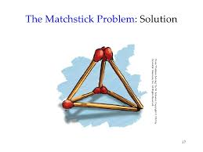
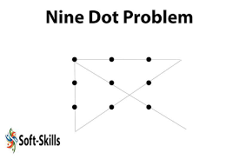

Slide 21
Artificial Intelligence: A branch of science that studies the capacity of computers to demonstrate performance that, if it were produced by human beings, would be described as showing intelligence
Are computers intelligent: computers carry out complex computations at blinding speeds, more proficient than people at doing repetitive tasks requiring speed and accuracy, useful in situations deemed too dangerous for humans
?Language limitations: computers process information in a sequential fashion, the brain processes the input from all of our senses simultaneously through a complex network of highly connected neurons
Computers possess large vocabularies, grasp syntax well enough to allow them to understand normal sentences, and know when to ask relevant questions if they do not understand or do not have enough information to act (Rensberger, 1993)
Difficult to teach computers to comprehend many of the subtleties of human speech
Neural Networks: Computer systems modeled after the brain and made up of highly interconnected elementary computational units that work together in parallel (Denning, 1992; Levine, 1991): the overall pattern results from millions of the individual units working together, neural networks have the capacity to learn from experience by adjusting the strength of the output from individual units based on new information

Slide 22
language
An extremely rich set of symbols, plus rules for combining them, to communicate information
Criteria for language as a system of communication:
Information must be transmitted by the symbols: words and sentences must carry meaning
The number of separate sounds or words in a language may be limited, it must be possible to combine these elements into an essentially infinite number of sentences
The meanings of these combinations must be independent of the settings in which they are used: sentences must be able to convey information about other places and other times

Slide 23
Language involves two major components: the production of speech, and its comprehension
The Production of Speech: All spoken language consists of phonemes, a set of basic sounds; morphemes, the smallest units of speech that convey meaning; and syntax, rules about how these units can be combined into sentences
Speech comprehension: Noam Chomsky (1968): Surface Structure: The actual words of which sentences consist; Deep Structure: Information that underlies the form of a sentence and is crucial to its meaning
Theories of language:
Social learning view: speech is acquired through a combination of operant conditioning and imitation. Presumably, children are praised or otherwise rewarded by their parents for making sounds approximating those of their native language, parents often model sounds, words, or sentences for them. This view contends these basic forms of learning contribute to the rapid acquisition of language
Innate mechanism view (Noam Chomsky,1968): language acquisition is at least partly innate. Human beings, have a built-in neural system that provides them with an intuitive grasp of grammar—a language acquisition device (LAD): humans are prepared to acquire language and do so rapidly for this reason
Cognitive theory (Slobin, 1979): recognizes the importance of both innate mechanisms and learning. Children possess certain information-processing abilities or strategies that they use in acquiring language. These are termed operating principles and seem to be present, or to develop, very early in life
Some findings suggest that there may be a critical period for language development during which children find it easiest to acquire various language components (Elliot, 1981). If for some reason children are not exposed to normal speech at this time, they may find it increasingly difficult to master language (De Villiers & De Villiers, 1978)
Language development is the result of a complex process involving several aspects of learning, many cognitive processes, and perhaps various geneically determined mechanisms as well.

Slide 24
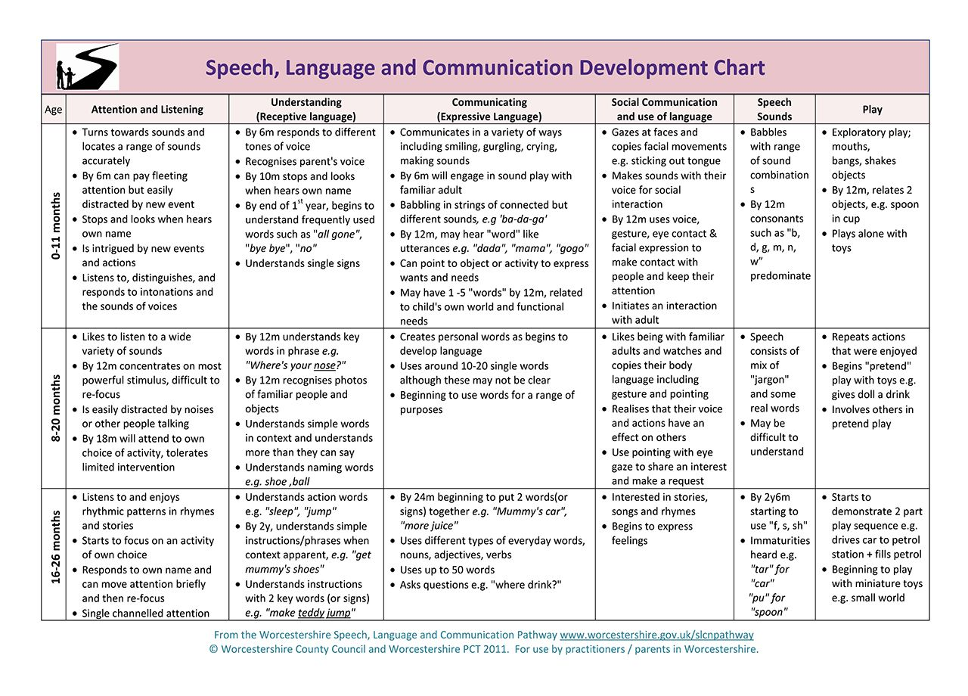

Slide 25
Basics of Language development:- three distinct but interrelated areas:
Phonological development—development of the ability to pronounce the sounds and words of one or more languages; development of the ability to produce recognizable speech
Semantic development—learning to understand the meaning of words; development of understanding of the meaning of spoken or written language
Acquisition of grammar—the rules by which words are arranged into sentences in a given language; rules within a given language indicating how words can be combined into meaningful sentences
Role of non-verbal communication: Kinesics (or body movements); Proxemics (or closeness/personal space); Posture; Eye contact; Touch; Para-language (sound of a voice outside a direct verbal translation of words being spoken; e.g.: tone, loudness); facial expressions; physiology (e.g.: blinking, staring, etc.)
Linguistic Relativity Hypothesis: The view that language shapes thought (Whorf, 1956): people who speak different languages may perceive the world in different ways because their thinking is determined, at least in part, by the words available to them VS thought shapes language, suggesting that language merely reflects the way we think—how our minds work.

